Slide 1
WTO Merchandise Trade Analysis with Neo4j
Deepak khirey & Gautam matkar
SQL and nosql, Summer 2019

Slide 2


Data source
https://data.wto.org/

Slide 3
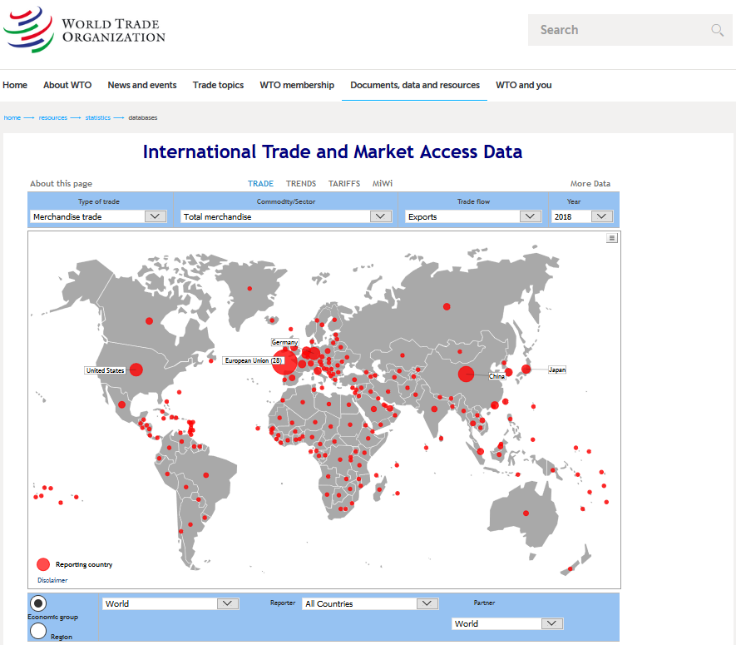
Wto Data link
https://www.wto.org/english/res_e/statis_e/statis_bis_e.htm?solution=WTO&path=/Dashboards/MAPS&file=Map.wcdf&bookmarkState={%22impl%22:%22client%22,%22params%22:{%22langParam%22:%22en%22}}

Slide 4
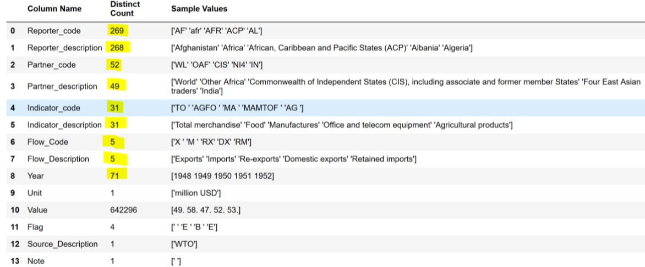
Data fields

Slide 5



Data preparation
WTO has provided dataset in CSV format
Good data quality
Data is complete
Data is sufficient
No Null’s
Data anomalies and remedy
Anomaly-Comma present in Country name
Remedy-Replaced comma with dash
Non relevant field dropped-”Flow Code”,”Flag”,”Source Description", "Note”

Slide 6
Data visualization
With tableau

Slide 7
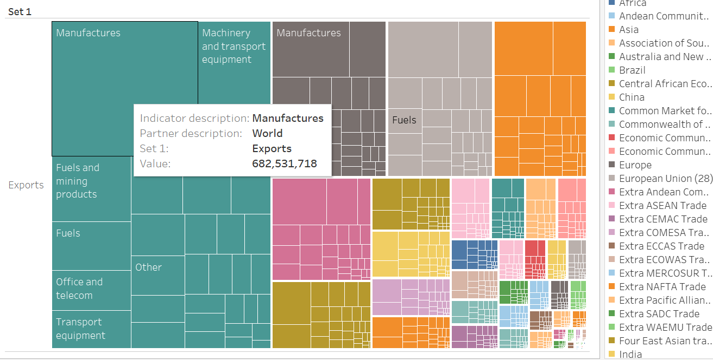
Export Heatmap

Slide 8
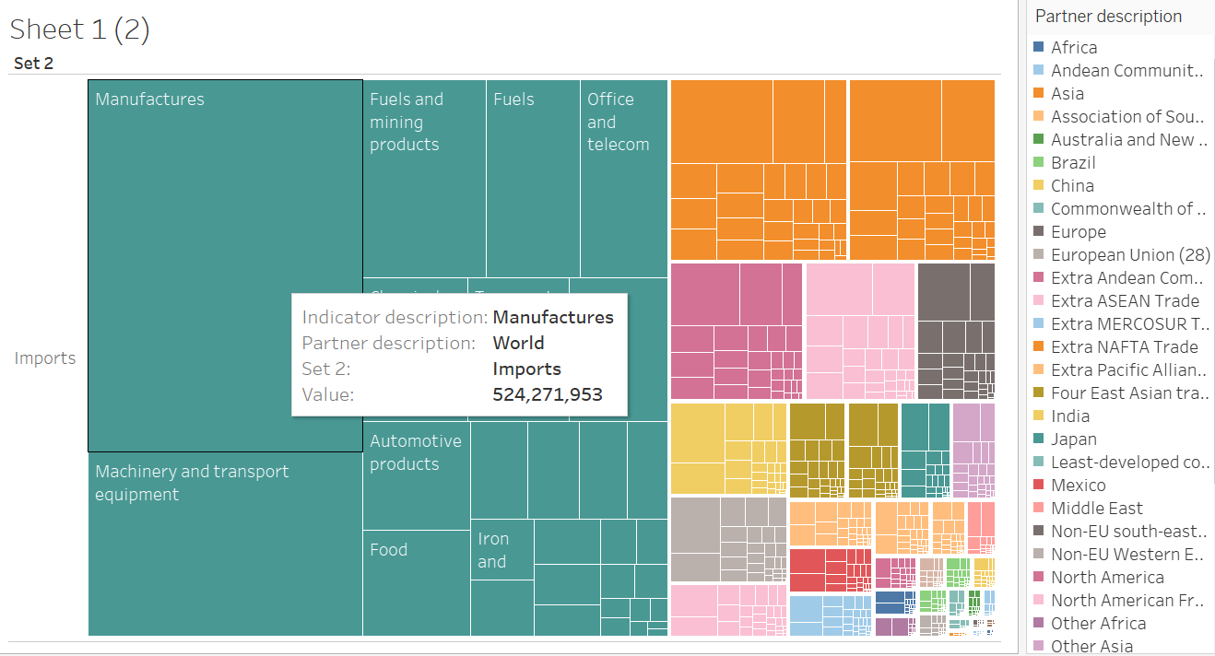
Import Heatmap

Slide 9
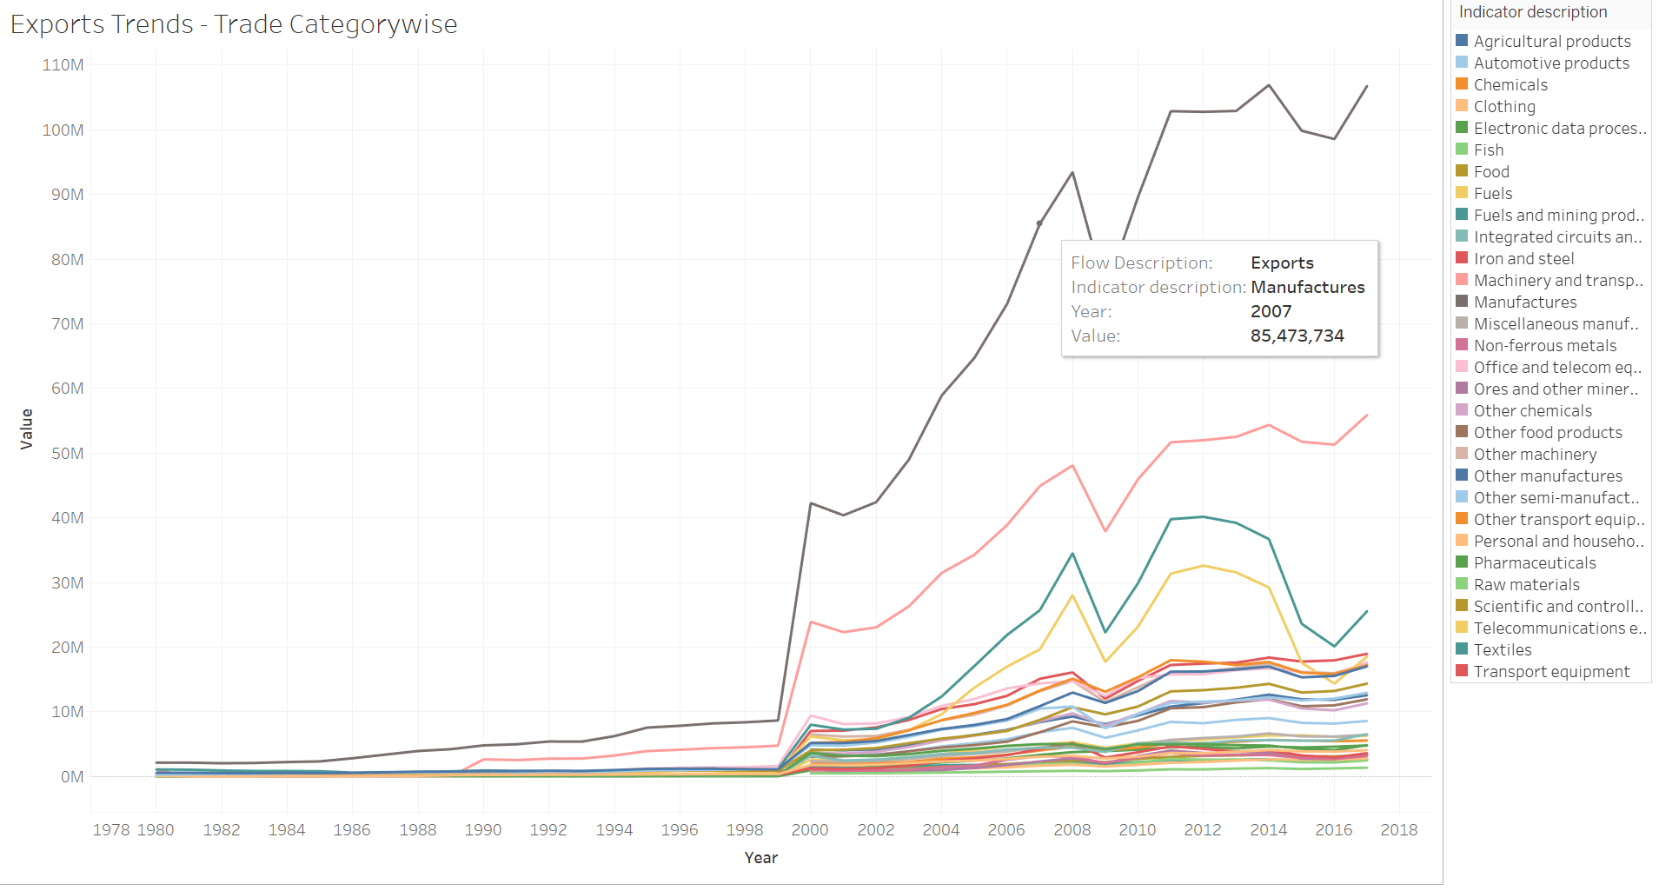
Export trend

Slide 10
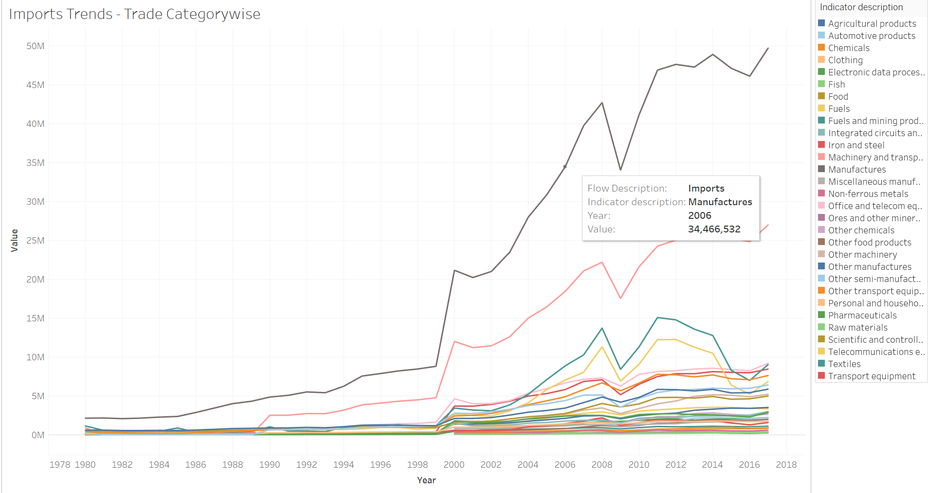
Import trend

Slide 11
Export Trade analysis
With neo4j

Slide 12
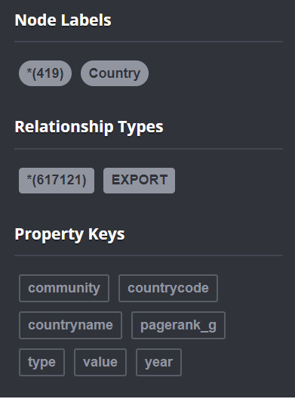
Data model
Country 1
Country 2
Export
Type
Year
Value
Countryname
countrycode
Countryname
countrycode

Slide 13
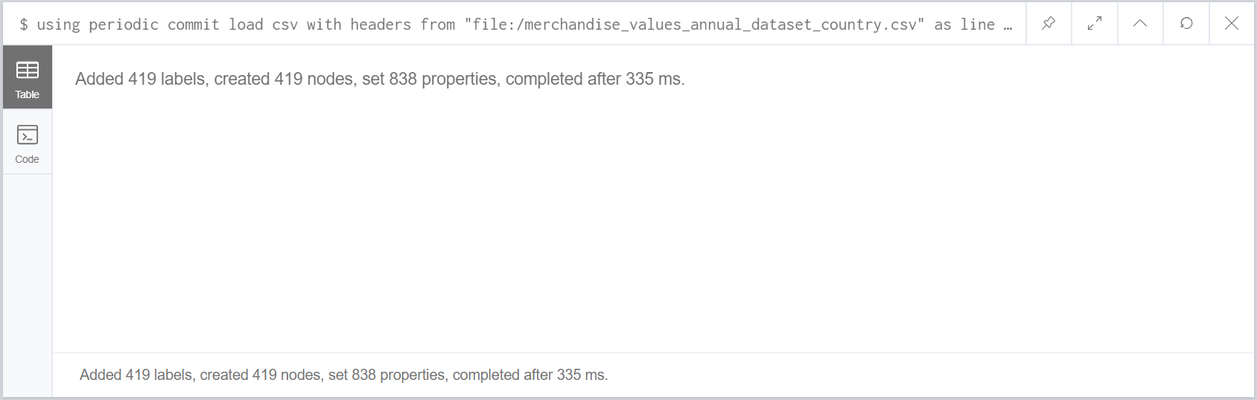
Create nodes
using periodic commit load csv with headers from "file:/merchandise_values_annual_dataset_country.csv" as line create (:Country { countryname: line.Reporter_description, countrycode:line.Reporter_code})

Slide 14
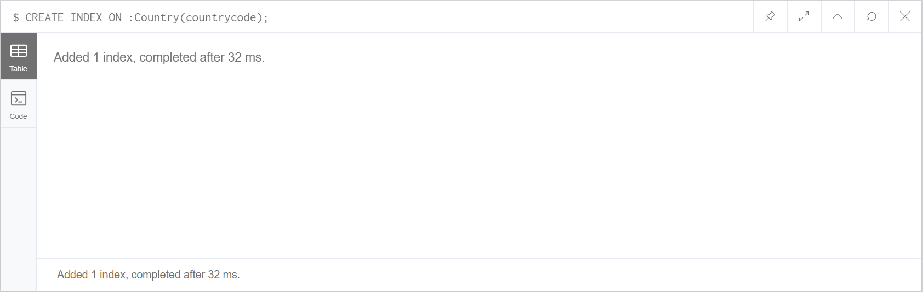
Index nodes
CREATE INDEX ON :Country(countrycode);

Slide 15
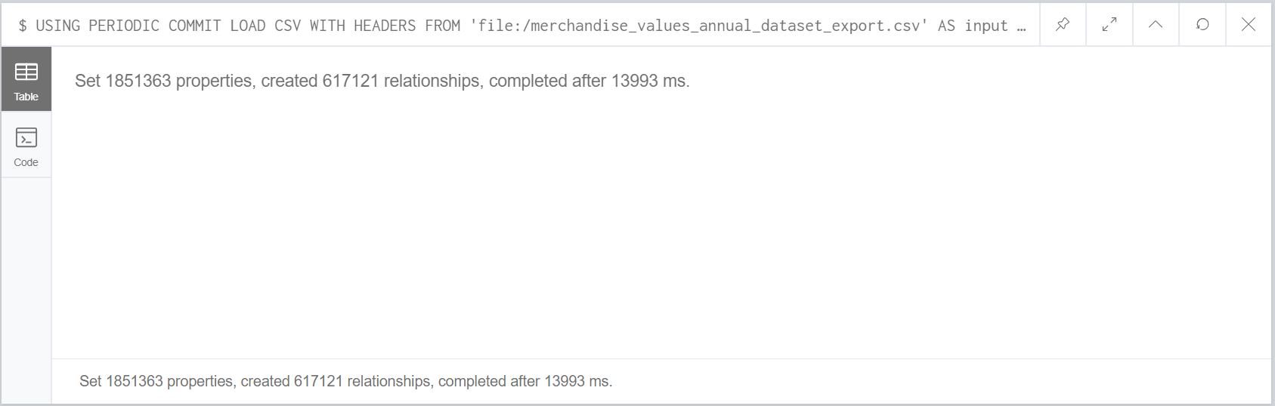
Create links
USING PERIODIC COMMIT LOAD CSV WITH HEADERS FROM 'file:/merchandise_values_annual_dataset_export.csv' AS input
MATCH (from:Country {countrycode:input.Reporter_code}), (to:Country {countrycode:input.Partner_code})
CREATE (from)-[:EXPORT {type: input.Indicator_description,year: input.Year,value: input.Value}]->(to);

Slide 16
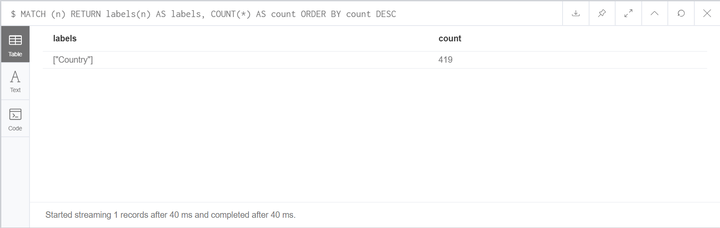
Count nodes
MATCH (n) RETURN labels(n) AS labels, COUNT(*) AS count ORDER BY count DESC

Slide 17
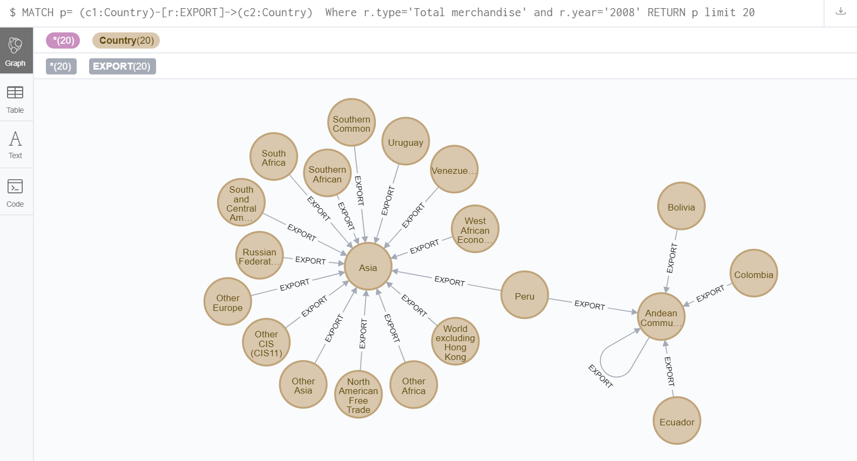
Query links
MATCH p= (c1:Country)-[r:EXPORT]->(c2:Country) Where r.type='Total merchandise' and r.year='2008' RETURN p limit 20

Slide 18
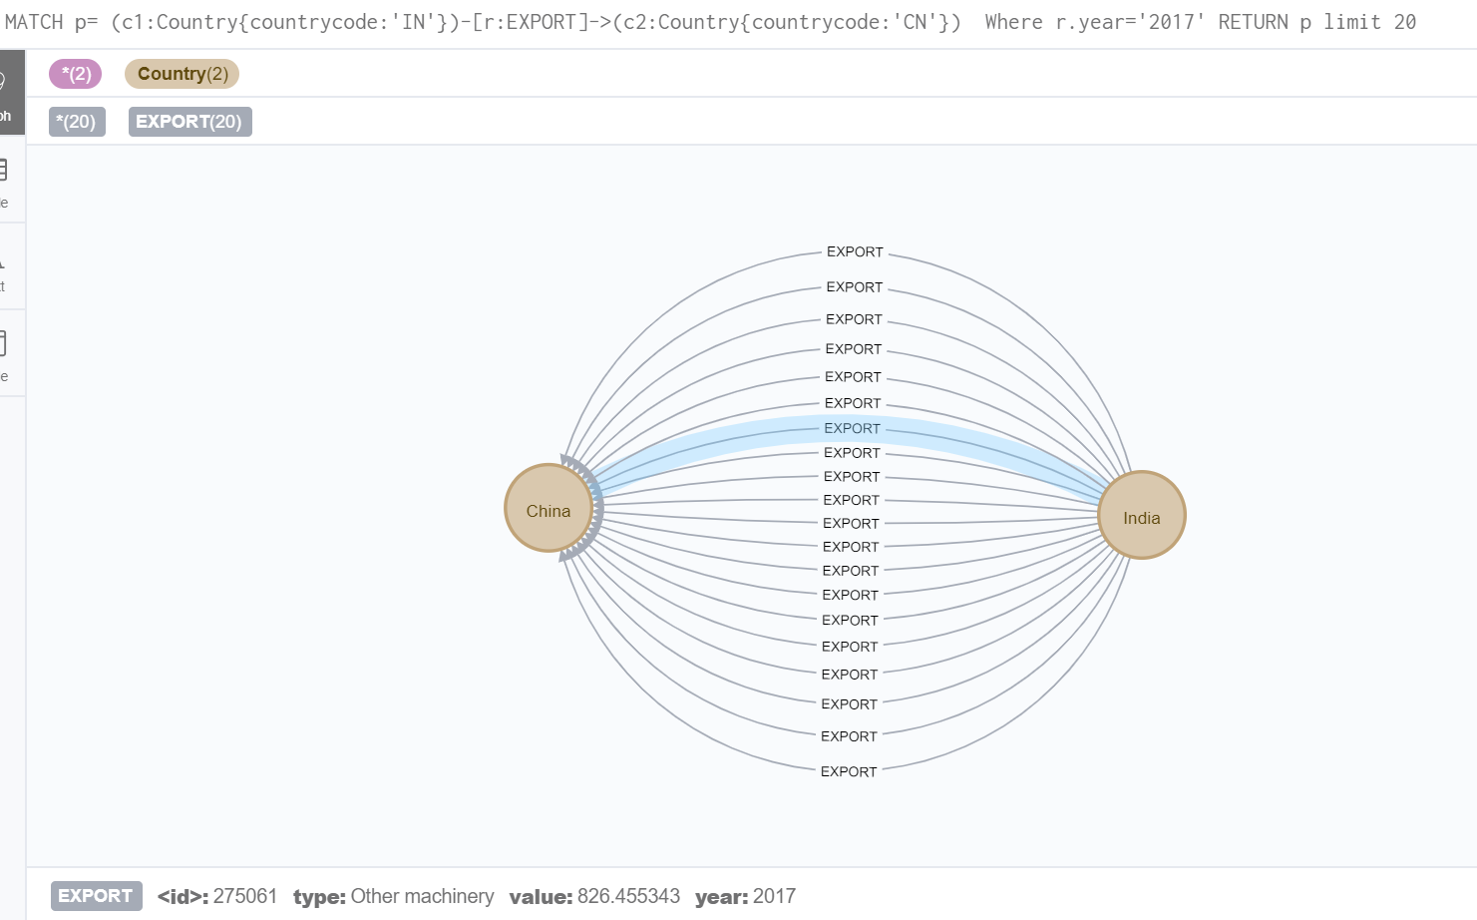
Query links
MATCH p= (c1:Country{countrycode:'IN'})-[r:EXPORT]->(c2:Country{countrycode:'CN'}) Where r.year='2017’ RETURN p

Slide 19
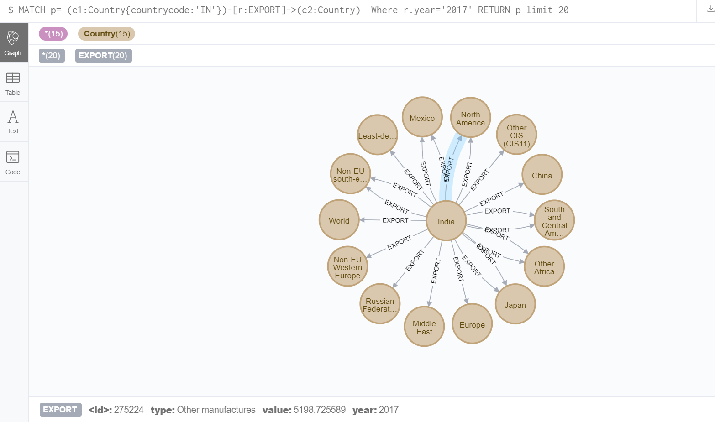
Query links
MATCH p= (c1:Country{countrycode:'IN'})-[r:EXPORT]->(c2:Country) Where r.year='2017' RETURN p limit 20

Slide 20
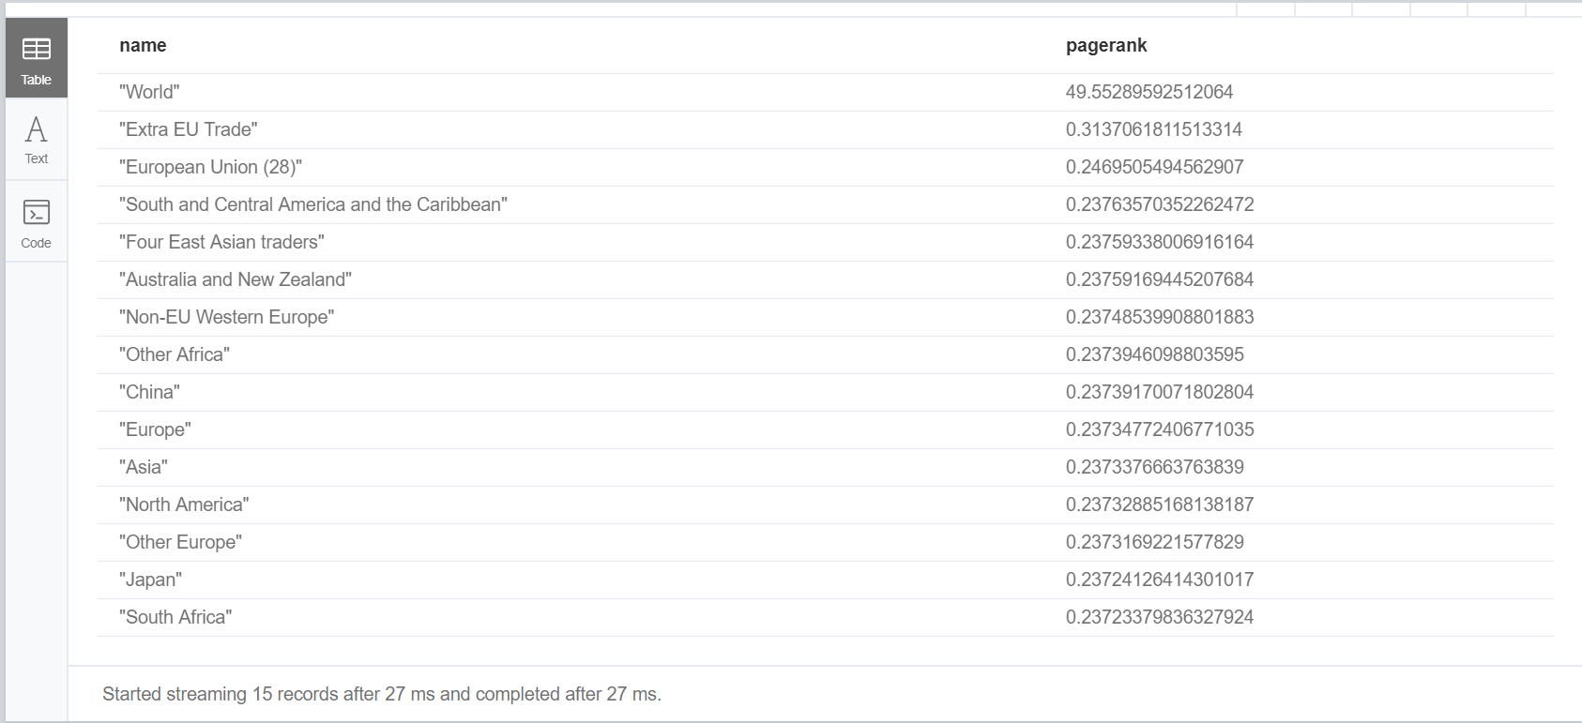
Pagerank algorithm
CALL algo.pageRank(null, null, {write:true, writeProperty: 'pagerank_g'})
MATCH (c:Country) WHERE exists(c.pagerank_g) RETURN c.countryname AS name, c.pagerank_g AS pagerank ORDER BY pagerank DESC LIMIT 15

Slide 21
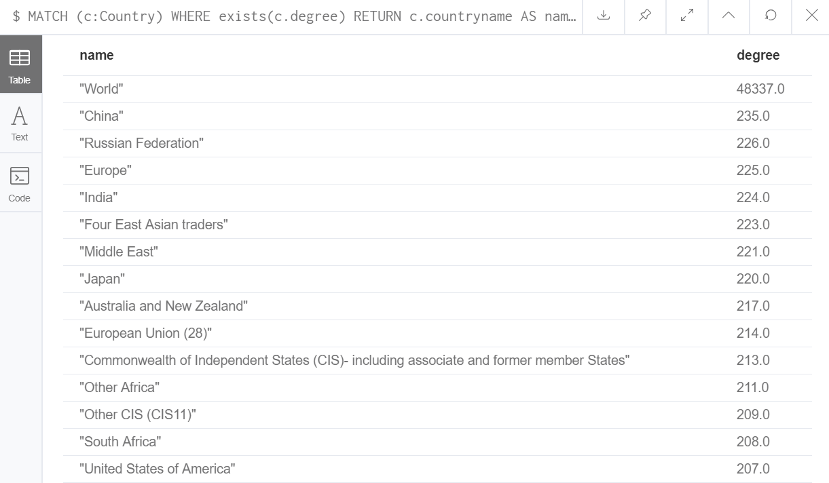
Degree centrality
CALL algo.degree("Country", "EXPORT", {direction: “incoming", writeProperty:"degree"})
MATCH (c:Country) WHERE exists(c.degree) RETURN c.countryname AS name, c.degree AS degree ORDER BY degree DESC LIMIT 15

Slide 22
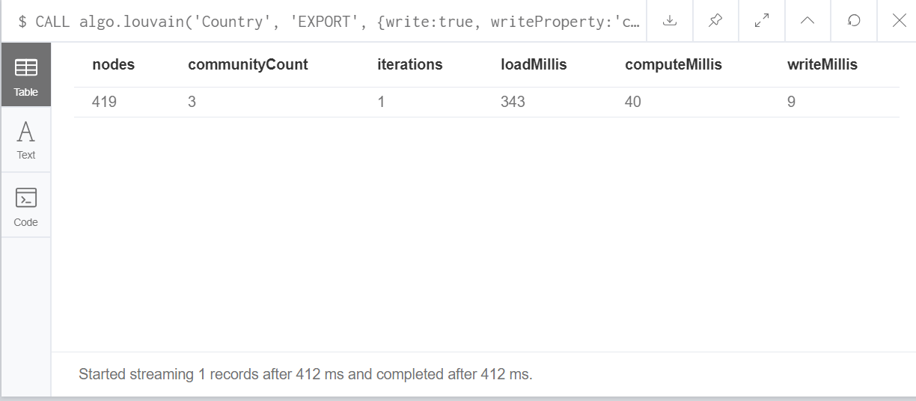
Community detection
CALL algo.louvain('Country', ‘EXPORT', {write:true, writeProperty:'community'})
YIELD nodes, communityCount, iterations, loadMillis, computeMillis, writeMillis;

Slide 23
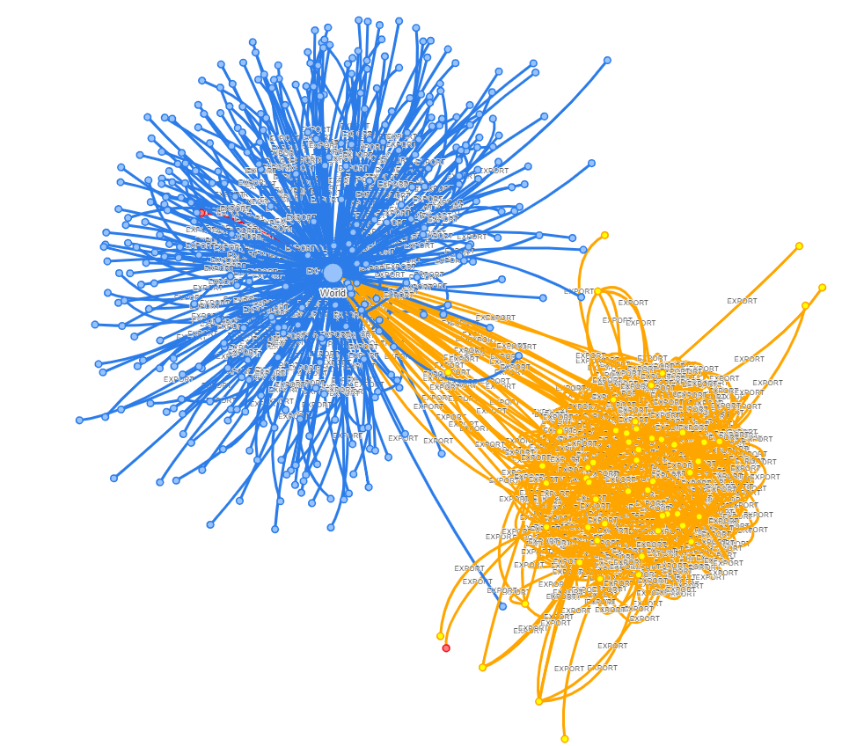
Neovis.js visualization
<script src="https://rawgit.com/neo4j-contrib/neovis.js/master/dist/neovis.js"></script>
</head>
<script>
function draw() {
var config = {
container_id: "viz",
server_url: "bolt://localhost:7687",
server_user: "neo4j",
server_password: "changeidea",
labels: {
"Country": {
caption: "countryname",
size: "pagerank_g",
community: "community"
}
},
relationships: {
"EXPORT": {
caption: false,
thickness: "value"
}
},
initial_cypher: "MATCH p= (c1:Country)-[r:EXPORT]->(c2:Country) Where r.type='Total merchandise' and r.year='2014' RETURN p"
}
var viz = new NeoVis.default(config);
viz.render();
}
</script>

Slide 24
Import trade analysis
With neo4j

Slide 25
Create nodes
using periodic commit load csv with headers from "file:/merchandise_values_annual_dataset_country.csv" as line create (:Country { countryname: line.Reporter_description, countrycode:line.Reporter_code})

Slide 26
Index nodes
CREATE INDEX ON :Country(countrycode);

Slide 27

Create links
USING PERIODIC COMMIT LOAD CSV WITH HEADERS FROM 'file:/merchandise_values_annual_dataset_import.csv' AS input
MATCH (from:Country {countrycode:input.Reporter_code}), (to:Country {countrycode:input.Partner_code})
CREATE (from)-[:IMPORT {type: input.Indicator_description,year: input.Year,value: input.Value}]->(to);

Slide 28
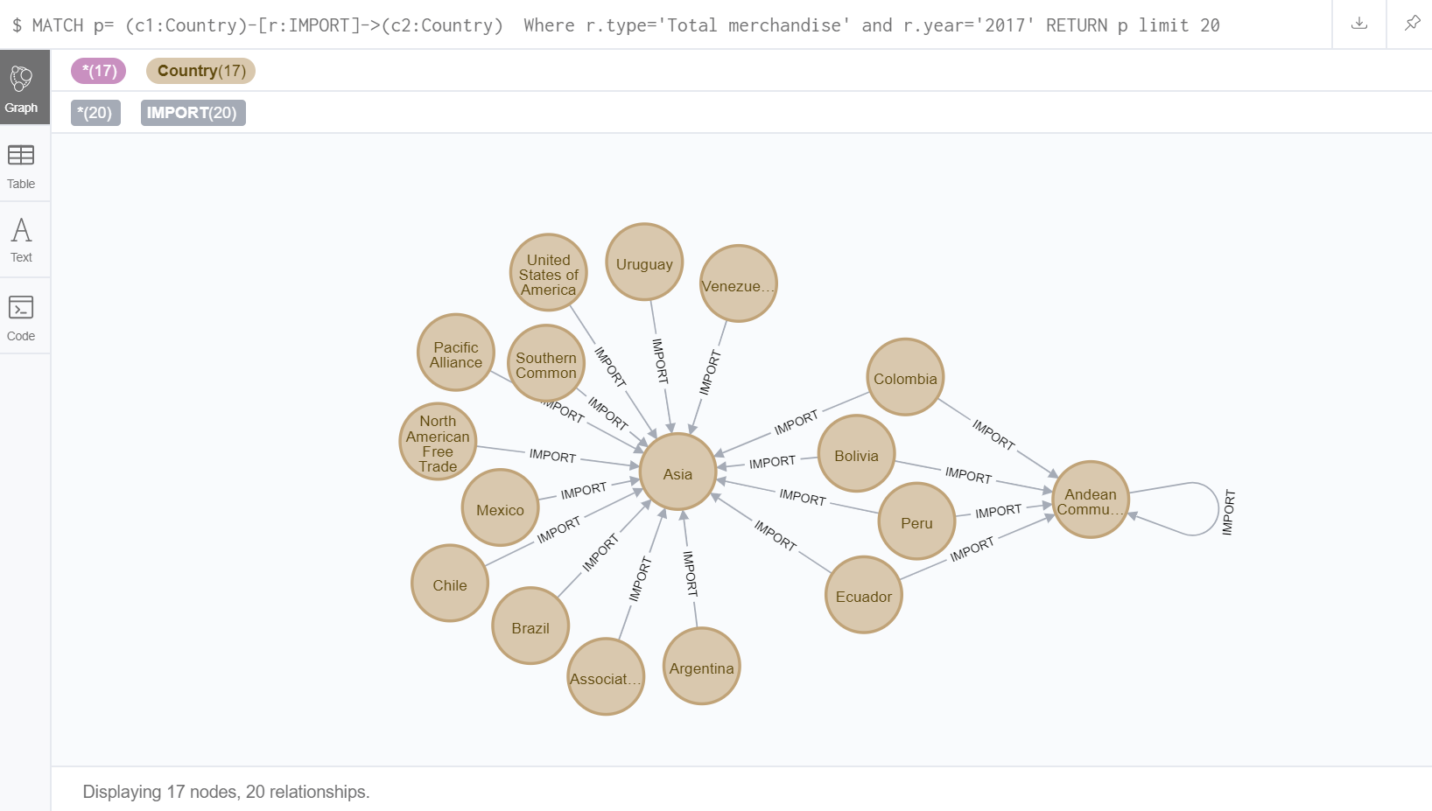
Query links
MATCH p= (c1:Country)-[r:IMPORT]->(c2:Country)
Where r.type='Total merchandise' and r.year='2017'
RETURN p limit 20

Slide 29
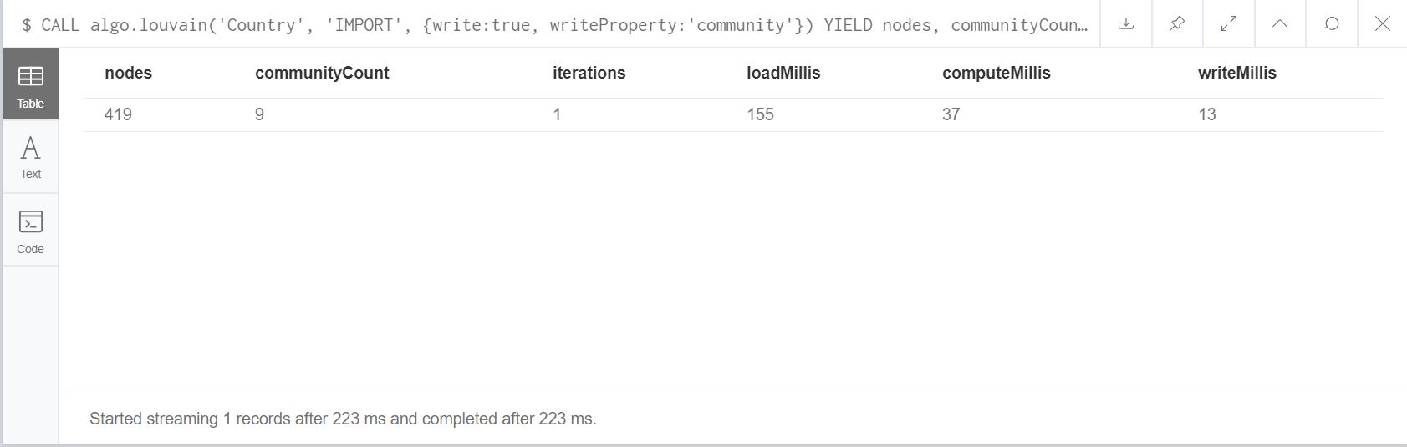
Community detection
CALL algo.louvain('Country', 'IMPORT',
{write:true, writeProperty:'community'})
YIELD nodes, communityCount, iterations, loadMillis, computeMillis, writeMillis;

Slide 30
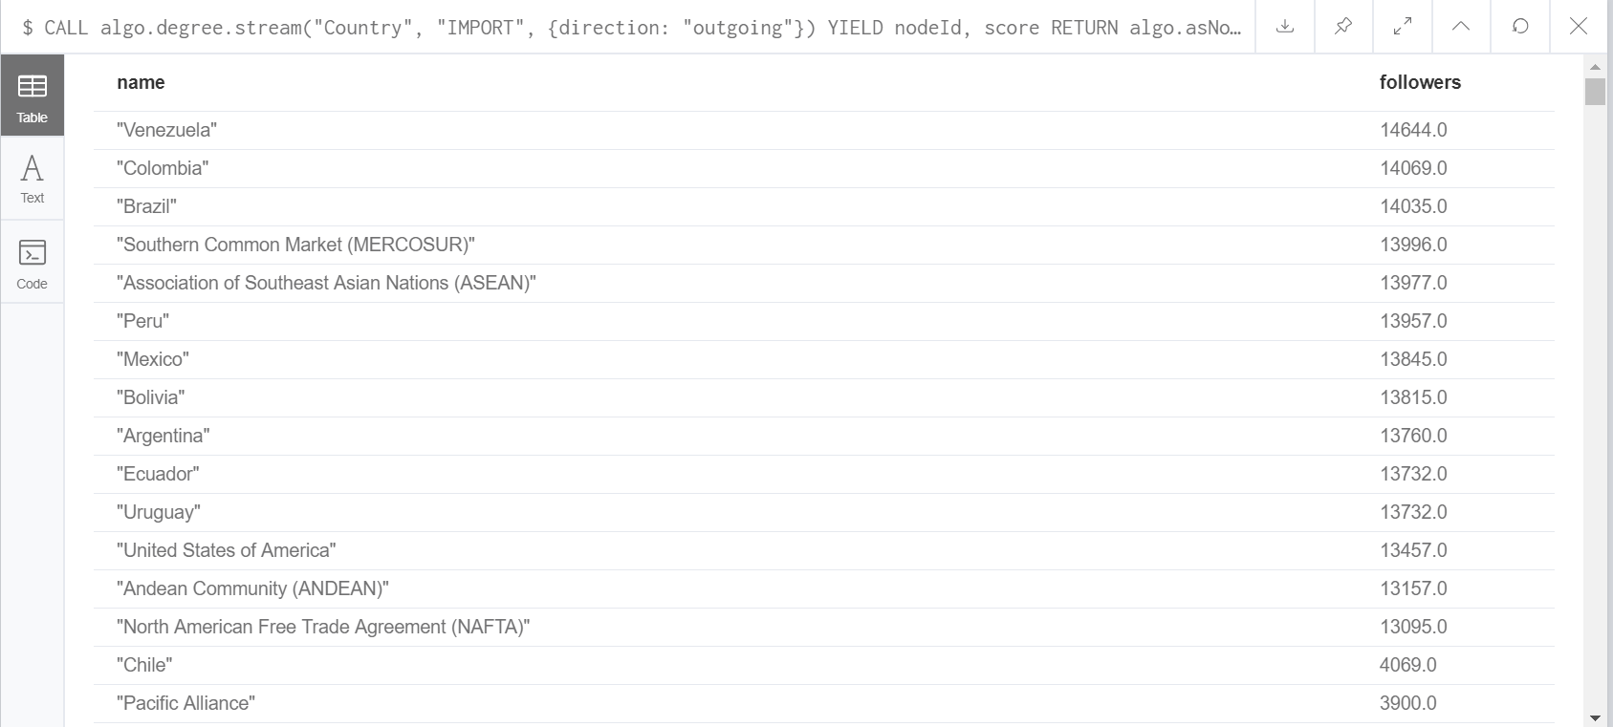
Degree centrality
CALL algo.degree.stream("Country", "IMPORT", {direction: "outgoing"})
YIELD nodeId, score
RETURN algo.asNode(nodeId).countryname AS name, score AS followers
ORDER BY followers DESC

Slide 31


